Slide 1
Cultural Evolution

Slide 2
Culture
“anything that is learned”
Eg. tool making, hunting techniques, use of language, preparation of food

Slide 3
Evolution of Behavior
Coupled with the brain’s evolutionary development is the increasingly complex behavior exhibited by hominids:
The Modern Human Mind
• Creating artifacts and images with symbolic meanings as a means of communication
• Using knowledge of animal habits, tools, advanced planning and communication to coordinate the hunting of large game
Natural History
Intelligence
Predict the future by understanding:
• the habits of game
• the rhythms of the seasons
• the geography of the landscape
Social
Intelligence
Group bonding behavior improves survival opportunities for members. Language allowed early humans to:
• communicate ideas
• plan survival strategies
• coordinate hunting and gathering
Technical
Intelligence
Producing and using artifacts required an understanding of abstract ideas and physical processes:
• the fracturing behavior of stone
• best angles of striking stone
• how hard to strike a stone
• trajectory of a thrown projectile

Slide 4
Australopithecine culture
Establishment of a ‘home base’
The home base a was a place in which hunter and gatherers would leave from and return to when collecting food.
Use of tools began to appear around 2.5 million years ago. Varied in size, generally shaped from river pebbles.
These tools are known as ‘Oldowan tools’ after the site where they were originally discovered.

Slide 5
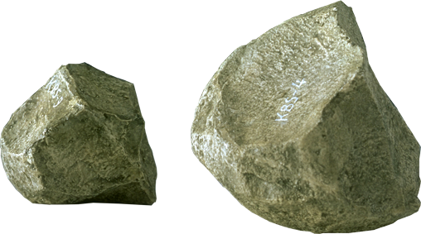
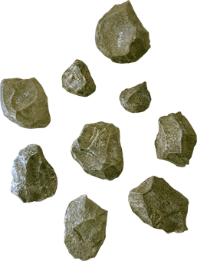

Oldowan Tool Culture
First Appeared: 2.6 M yrs ago
Associated Hominid: Australopithicine, Homo habilis
These tools were simple river-worn pebbles that were crudely fashioned with only a few flakes being removed.
These tools typically had flakes knocked from several angles to produce a core with a cutting edge (e.g. chopper, discoid, polyhedron).
Although the cores may have been used as tools, it is known that the sharp flakes were also useful in cutting.
Also useful as a scraping tool

Slide 6
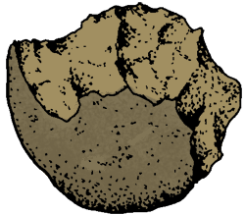
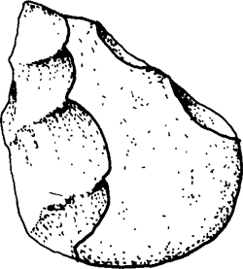
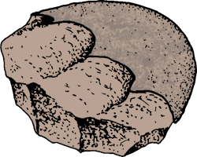
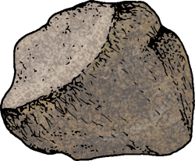
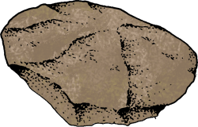
Oldowan Tool Culture
Flakes removed from 1 side only
Flakes removed from 2 sides
Core
Choppers
Proto-Biface
Flakes removed from all sides
Core
Polyhedron
Discoid

Slide 7
Early Homo
As evolution has occurred from Australopithecine to early Homo (eg Homo habilis), the overall size of the cerebrel cortex has increased.
In order for growth of the brain to occur a species is required to consume a very high fat diet. Where is the fat obtained?
Meat
Evidence suggests that for early Homo, more often than not hunting parties would return empty handed. This indicates that for a regular supply of meat to be available ‘food sharing’ would have been necessary.
This is an important social development

Slide 8
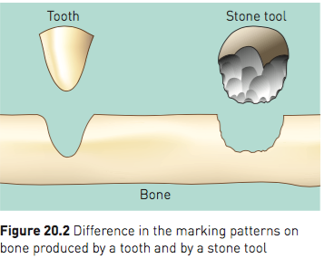
Early Homo cont.
Early Homo were not only hunters but also scavengers
Fossil analysis of animal bones found gives indication that stone tools were not always used
After close analysis of fossils scientists are able to determine the difference between stone tool marks and carnivorous tooth marks.
Analysis of these bones suggest early Homo were both hunters and scavengers.

Slide 9
Homo erectus culture
Hominin culture had now evolved to a point where environmental pressures were having little impact and species were choosing/manipulating their environment.
Homo erectus were able to make fire as well as build shelters which resulted in the environment having less of an impact on survival.
Tool production had also changed. They were now using stone tools as ‘hand axes’ which were known as Acheulian tools.

Slide 10
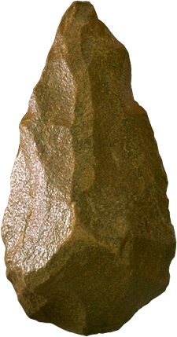
Acheulian Tool Culture
First Appeared: 1.7 M yrs ago
Associated Hominid: Homo erectus
These tools were typically 'tear drop' in shape and were carefully crafted with a slight bulge on each broad surface (called a 'bi-face').
They ranged greatly in their size and are often called 'hand axes' although it is not clearly understood how they were used.
They differ markedly from the earlier pebble tools in that there appears to be a standard “design” and each tool is manufactured using a great many more blows to remove flakes.

Slide 11
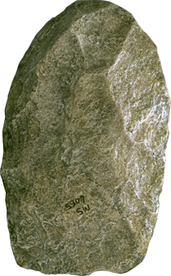
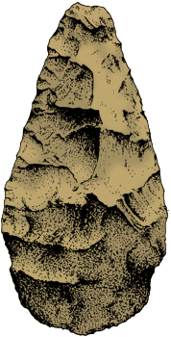
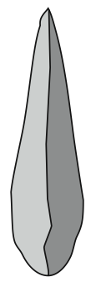
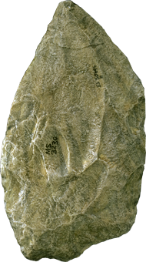
Acheulian Tool Culture
Hand axe
Typical 'tear-drop' shape of an Acheulian biface tool
The core is the tool
Flatter and more ‘blade-like’
The core is the tool
‘Biface’ shape – bulges outwards on both sides and has ‘tear drop’ shape
Cleavers
Side-on view

Slide 12
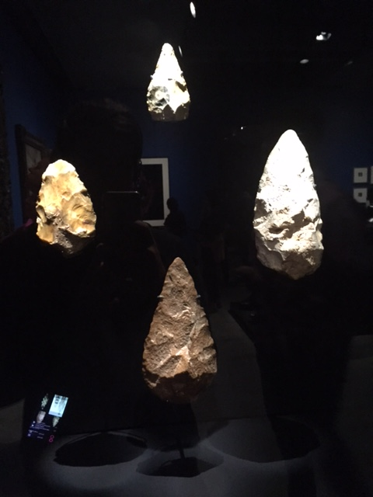

Slide 13
Homo erectus culture cont.
Many fossils have been found across the world indicating that H. erectus relied heavily on hunting.
These sites also indicate development in hunting techniques.
One site in particular indicates the sight of a large scale baboon slaughter. The site has evidence which suggests that stone tools were carried from up to 33km away which indicates the slaughter was a well planned pre-conceived idea.
This obviously indicates development in thinking and communication.

Slide 14
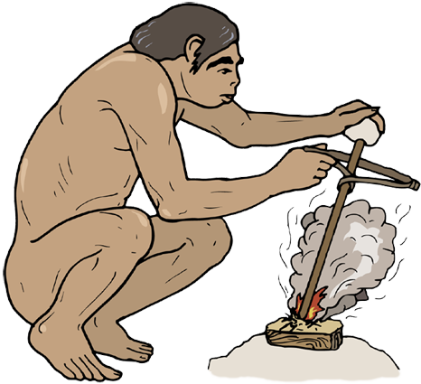
Use of Fire
The earliest record of humans using fire:
Africa: 1.5 mya (although this date is disputed)
France: 750 000 ya
China: 500 000 ya
At first, fire may have been ‘captured’ from natural sources, such as bush fires caused by lightning.
Later, humans developed techniques to create fire on demand.

Slide 15

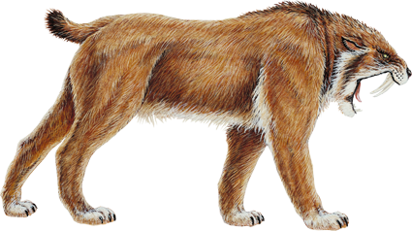
Use of Fire
With fire early humans could:
Remain active at night: People began using fire as a source of light to continue their activities after dark and inside their caves.
Cooking with fire: Made the meat of the animals they killed more palatable and digestible. They learned to preserve meat by smoking it over a fire, vastly decreasing the danger of periodic starvation. Cooking also enabled them to add some formerly inedible plants to their diet.
Make better weapons and tools: Hunters formed spears from tree branches by burning the tips of the branches and then scraping the charred ends into a point.
Protect themselves from predators
Warm themselves

Slide 16
Neanderthal culture
Greater development in tool manufacture – using stone flakes that can be trimmed for various functions such as cutting, scraping, piercing and gouging.
Referred to as the the Mousterian industry
First species who are believed to have buried their dead

Slide 17
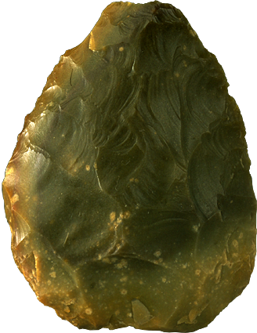
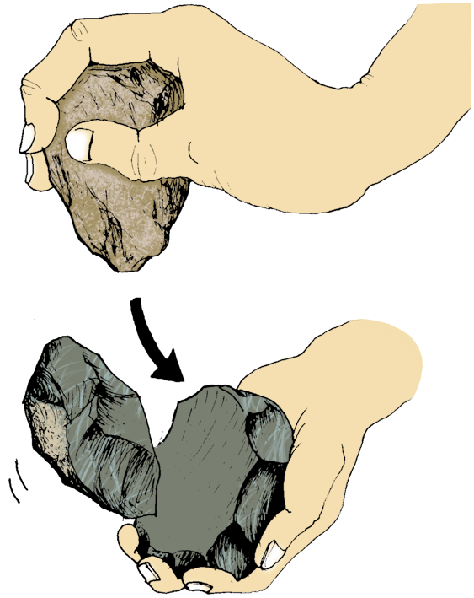
Mousterian Tool Culture
First Appeared: 200 000 yrs ago
Associated Hominid: Homo neanderthalensis
More refined tool culture than the earlier Acheulian tool culture.
Flint became a preferred material to produce stone tools because of the very predictable way in which it would chip when struck with another hard object (much finer workmanship was possible).
The Levallois tool making method involved preparing a core and striking off a large oval flake which was then retouched on one surface only.
Making a scraper by the Levallois method

Slide 18
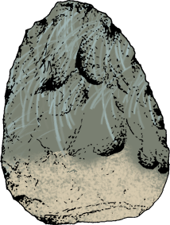
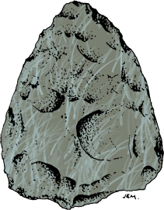
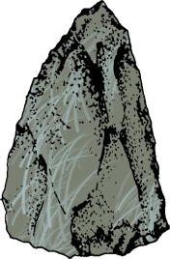
Mousterian Tool Culture
Side scraper
from Le Moustier, FranceFlint, length 9cm
The scraper made by the Levallois flake method is retouched on one surface.
Handaxe
from Le Moustier, FranceFlint, length 8.5cm
Levallois point from Le Moustier, FranceFlint, length 6cm

Slide 19
Modern humans
Transition to using more blade like tool as well as using projectile weapons eg spear.
Rapid acceleration of tool development around 50,000 years ago, believe to have possibly stemmed from a mutation which increased brain function.
Allowed modern humans (Cro-Magnon) to move into the colder climates of Europe as they were able to produce better quality clothing and shelters.
Also became very good at hunting large game and using the geographical landscape to do so.

Slide 20
Modern humans cont.
3 main tool cultures associated with the Cro-Magnon people.
Aurignacian
43, 000 - 26, 000 years
Blade tools
Solutrean
22, 000 – 19, 000 years
‘laurel leaf’ points blade
Magdalenian
18, 000 – 12, 000 years
Bone and antler tools
Use of ‘burin’ to shape bone, antler and ivory into tools

Slide 21
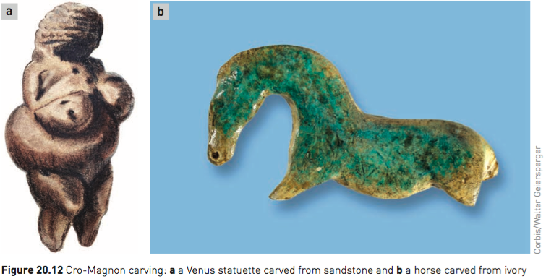
Modern humans cont.
Cro-Magnon art

Slide 22
The Denisovans
Fragment of bone in Denisova Cave (Siberia) in 2008 was dated to approximately 40, 000 years ago.
Mitochondrial DNA analysis indicated the bone did not belong to either Neanderthal or modern human.
Nuclear DNA indicates Denisovans are more closely related to Neanderthals than modern humans, however a tooth found from the same site shows a distinct difference in size. This shows there was an anatomical difference.

Slide 23
The Red Deer Cave people
Skull discovered in China which does not resemble that of modern humans.
Had thick bones, , prominent brow ridges, short flat face and lack of human like chin.
Different theories as to where they have originated from and where they fit into the fossil record.
Scientist believe they cooked large deer, hence the name Red Deer Cave people.

Slide 24
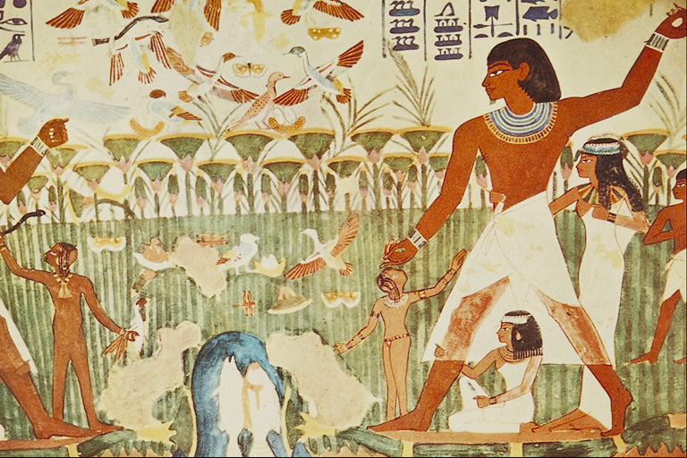
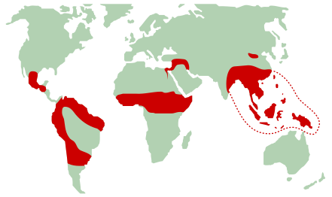
The Beginning of Agriculture
Farming began in different parts of the world at different times:
Earliest evidence is found in the so-called ‘fertile crescent’ running from Egypt to the Persian Gulf about 10 000 years ago.
By about 7 000 years ago, agriculture became established in China.
This was followed by Mesoamerica (Guatemala, Honduras and southern Mexico) about 5 000 years ago.

Slide 25
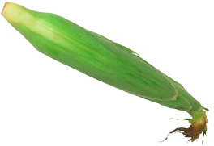

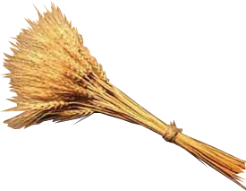



The Beginning of Agriculture
Fertile CrescentBarley, wheat, emmer, einkorn, lentils, peas, sheep, goats, cattle10 000 years ago
North China
Rice and millet
7 000 years ago
Mesoamerica
Beans, maize, peppers,
squash, gourds, cotton,
guinea-pigs, llamas
5 000 years ago
South America
Lima beans, potatoes, squash, beans, and pumpkins
5 000 years ago
Africa
Millets, sorghum, groundnuts, yams, dates, coffee, and melons
> 4 000 years ago
Southeast Asia
Rice, bananas, sugar cane, tea, citrus fruits, coconuts, yam, millet, soya beans, taro, pigs
> 4 000 years ago

